Slide 1
Loan Eligibility Analysis Report
Project by Tarun Kale
Role: Data Analyst
Tools Used: Python, Excel, Pandas, Matplotlib, Seaborn
Dataset Source: Loan Dataset (614 rows × 13 columns)
Tools Used: Python, Excel, Pandas, Matplotlib, Seaborn
Objective:
To analyze the factors that affect loan approval decisions such as gender, income, education, credit history, and property area and identify key patterns for loan eligibility.

Slide 2
Column Name | Description
Gender | Male / Female
Married | Marital Status
Dependents | Number of dependents
Education | Graduate / Non-Graduate
Self_Employed | Employment type
LoanAmount | Amount applied for
Loan_Amount_Term | Loan duration (months)
Credit_History | 1 = Good, 0 = Bad
Property_Area | Rural / Semiurban / Urban
Loan_Status | Y = Approved, N = Not Approved
overall_income | Total Income (Applicant + Coapplicant)
Final Columns in Dataset
Dataset Overview
Content:
The dataset contains demographic, financial, and credit-related details of applicants.
After cleaning and transformation, total 11 columns were used for analysis.
Unnecessary columns like Loan_ID were removed.
Created a new derived column: 🧮 overall_income = ApplicantIncome + CoapplicantIncome

Slide 3
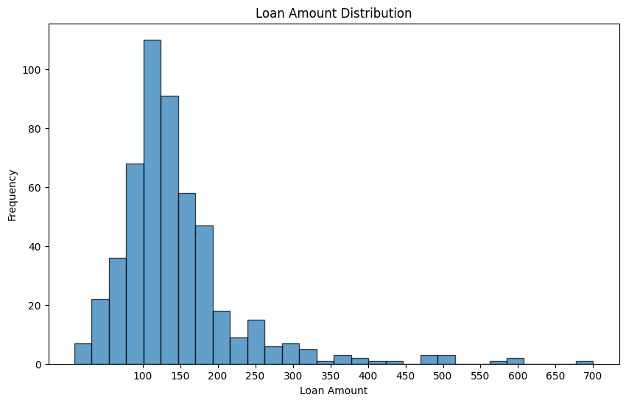
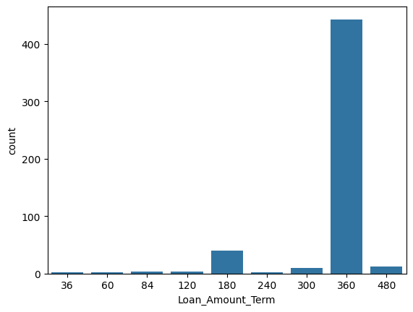
Data Analysis: Univariate Analysis
In this step, we analyze key financial features like Loan Amount, Loan Amount Term, Overall Income, and Credit History individually.
This helps to understand applicant behavior and major patterns before exploring how these factors affect loan approval.
Loan amounts range from $9,000 to $700,000.
Average loan amount: ≈ $146,000.
Most applicants applied for medium-sized loans between $100K–$200K.
Most common term: 360 months (30 years).
Average loan term ≈ 342 months.
Indicates preference for long-term repayment (lower EMI).

Slide 4
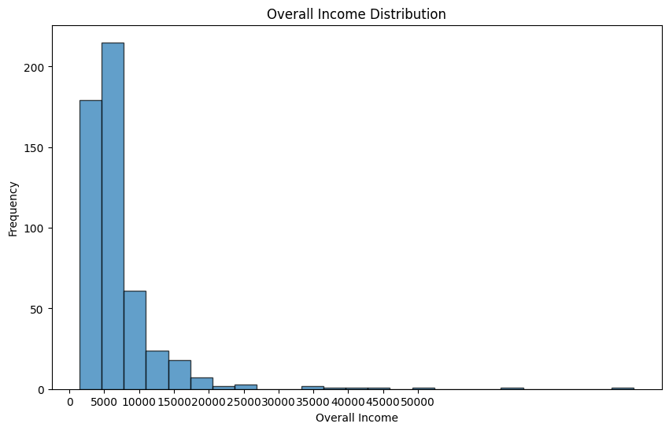
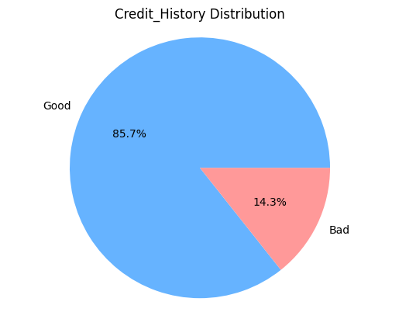
Applicant incomes range from $14,412 to $81,000.
Average income: ≈ $70,970.
Majority belong to middle-income group.
443 applicants have a good credit history; only 74 have bad.
Majority applicants are financially reliable, increasing chances of loan approval.

Slide 5
Final Conclusion (for all four plots):
Most applicants are middle-income earners who apply for moderate loan amounts and prefer long-term repayment plans (30 years).
Additionally, the majority have a good credit history, which shows that most customers are financially stable and more likely to get loan approval.

Slide 6
Bivariate Analysis (Loan_Status vs Key Factors)
Will gender affect loan approval?
Total eligible applicants = 300 (sum of approved males & females).
Insight: Males have slightly higher absolute approvals; gender alone isn’t decisive once other factors (credit, income) are considered.
Loan approval depends on financial stability, credit history, income, and documentation Gender alone does not determine this.
Gender status does not strongly influence loan approval.
Will marital status affect loan approval?
Married applicants show higher approvals in absolute numbers (243 approved), but proportionally, unmarried applicants are not very far behind.
Insight: Marital status does not strongly influence loan approval.
Education vs Loan Status
Answer: 294 educated (graduates) are eligible (Loan_Status = Y).
Insight: Graduates show higher approvals education correlates with employability/stable income.

Slide 7
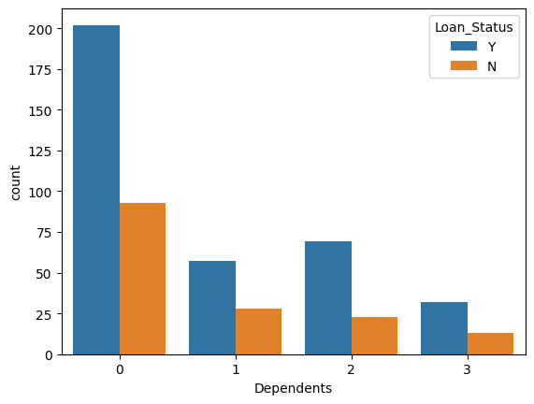
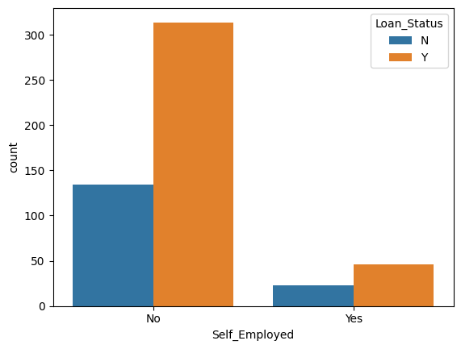
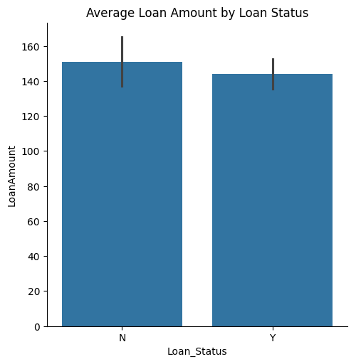
Dependents: 0:295, 1:85, 2:92, 3+:45 (dataset frequency shown on chart).
Insight: Applicants with fewer dependents (0) have larger absolute approvals and fewer financial liabilities, which improves repayment capacity.
46 self-employed applicants are eligible. Insight: Self-employed applicants show lower approval rates compared to salaried; lenders may be stricter for irregular incomes.
Average LoanAmount (Approved) ≈ 144.0; Overall average ≈ 146.145.
Insight: Approved loans have slightly smaller average amounts smaller loan requests marginally favor approval.

Slide 8
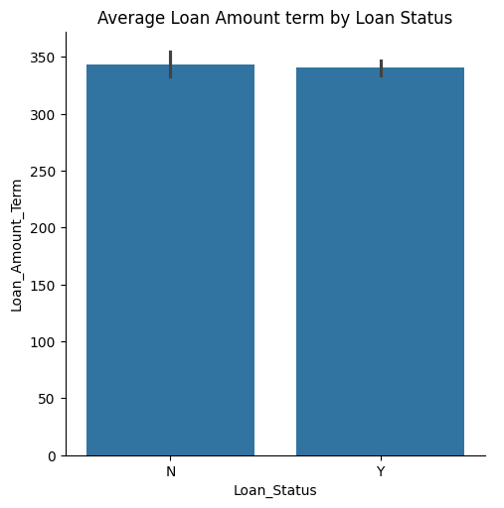
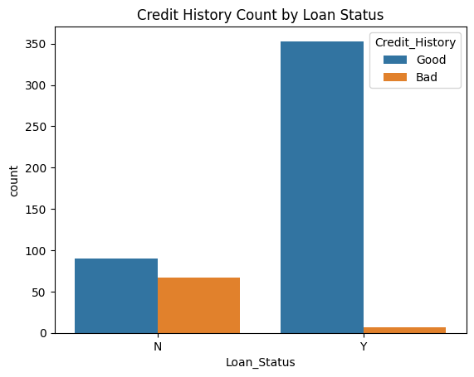
Average approved term ≈ 342 months; most common = 360 months (30 years).
Insight: Approved applicants predominantly choose long-term loans lenders accept longer tenures for affordability.
Credit History:353 eligible applicants have good credit history (Loan_Status = Y & Credit_History =1). Insight: Good credit history is the strongest predictor — approvals concentrate in credit-good group.

Slide 9
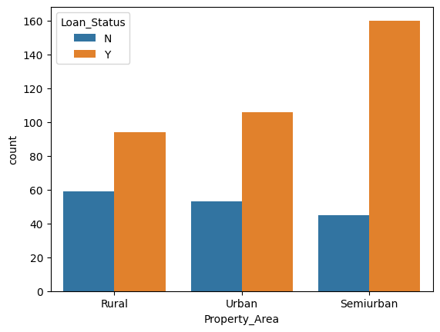
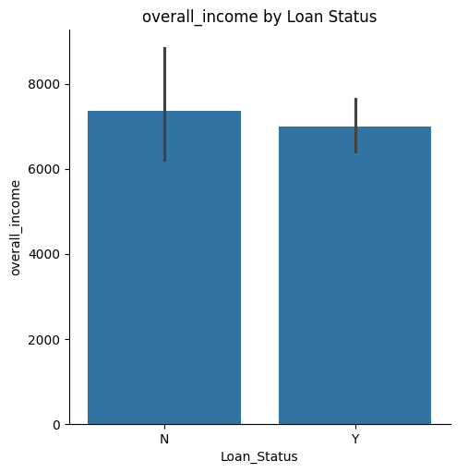
Semi-Urban: Y = 160, N = 45;
Rural: Y = 94, N = 59
Urban: n=53 y=106
Insight: Semi-urban applicants have higher approvals possibly better income/documentation or bank focus in semiurban zones.
Mean overall income Eligible (Y): 6,985.91 ; Not eligible (N): 7,352.69.
Insight: Surprisingly, rejected applicants have slightly higher mean income income alone doesn’t guarantee approval; credit history, dependents, loan amount and documentation matter more.

Slide 10
Overall conclusion
Combined Conclusion: Credit history is the dominant factor in loan approval. Marital status and education positively correlate with approval counts, while self-employment reduces approval probability. Applicants with fewer dependents and lower-to-moderate loan amounts are more often approved. Property area (semi-urban) shows higher approvals. Income alone is not decisive Loan eligibility depends on a combination of credit reliability, loan size/term, and applicant profile.

Slide 11
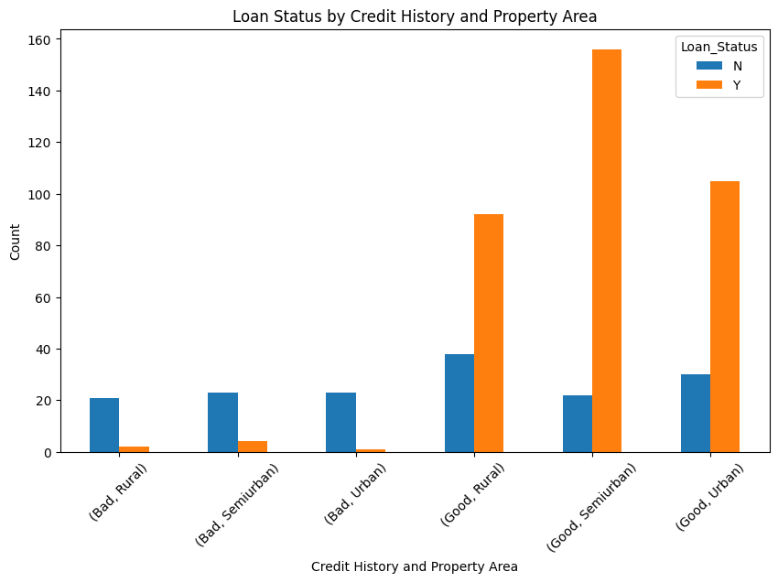
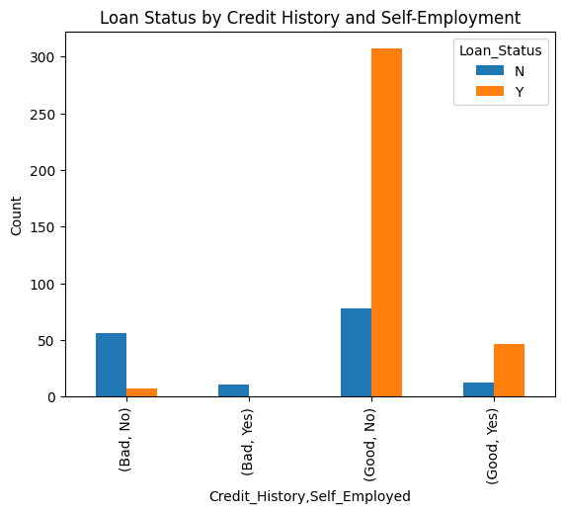
Multivariate analysis
Applicants with good credit history have a much higher loan approval rate across all property areas. Semiurban areas show the highest approval rate 88% among good credit applicants.
Bad credit history leads to very high rejection rates (above 85% in all areas).
Credit history is the key factor influencing loan approval, regardless of location. Applicants with good credit, especially from semiurban areas, are most likely to get approved.
Applicants with good credit history — whether self-employed or not — have a high loan approval rate (~79%).
Those with bad credit history face almost complete rejection (85–100%), regardless of their job type.
Self-employment alone doesn’t strongly influence approval unless credit history is good.

Slide 12
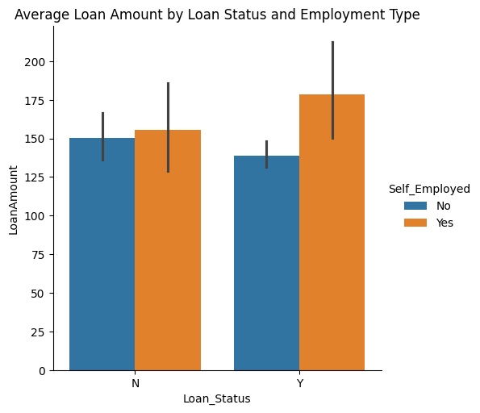
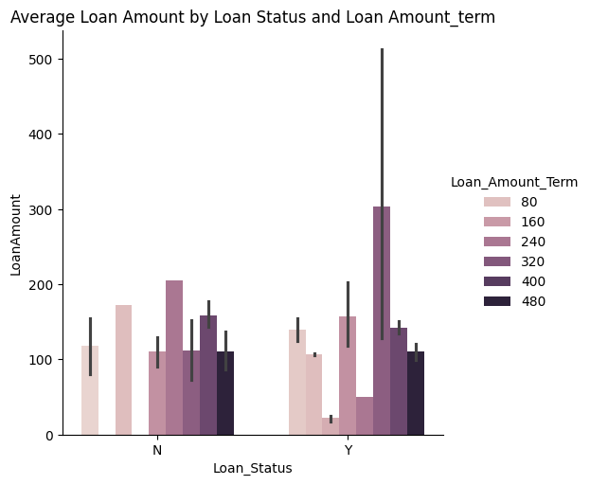
Self-employed applicants receive slightly higher approved loan amounts (~$178K) compared to non-self-employed (~$139K).
💡 Self-employed individuals tend to secure larger loan approvals
Medium-term loans (180–300 months) show more approvals.
Short or long-term loans have mixed results.
💡 Loan term affects approval slightly, but credit history matters more.

Slide 13
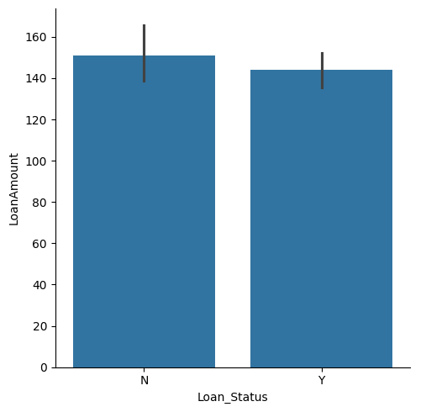
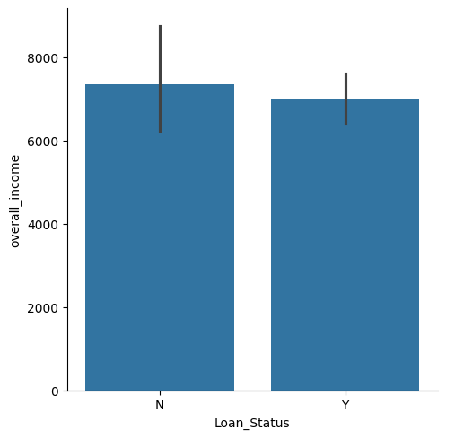
Approved applicants have slightly lower average loan amount (144K) and income (6985) than rejected ones.
💡 High income or high loan amount alone doesn’t guarantee approval.

Slide 14
Conclusion
The analysis reveals that credit history is the strongest determinant of loan approval, outweighing the effects of income, employment type, or loan amount. Self-employed applicants with higher incomes tend to receive larger and more frequent approvals compared to those with lower earnings. While loan amount and term show mixed effects, approvals are still mainly driven by good credit records. Property area interacts with credit history, where semi-urban applicants with good credit have the highest approval rates. Overall, a good credit history combined with stable income significantly increases the likelihood of loan approval.

Slide 15
Thank you! We have analyzed various factors (like gender, marital status, education, income, credit history, and property area) affecting loan approval. The analysis shows that:
Credit history is the strongest factor influencing loan eligibility.
Other factors like gender or marital status have minimal impact.
Data-driven insights like these help lenders make fair and reliable loan decisions.
📊 Prepared by: Tarun Kale 🎓 Course: Data Analytics (Naresh IT) 📅 Project: Loan Eligibility Analysis

Slide 16
Thank you
Ready for what’s next?
Let’s talk
Full Name (of the point of contact)
Email
Phone number
Company Name
Quarter Month
Year

Slide 17
Content
1
Add section title
2
Add section title
3
Add section title
4
Add section title
5
Add section title
6
Add section title
Company Name
Quarter Month
Year

Slide 18
Thank you
Ready for what’s next?
Let’s talk
Full Name (of the point of contact)
Email
Phone number
Company Name
Quarter Month
Year

